Slide 1

Minimum Spanning Trees
James Bloor
MET CS 566
Term Project
Spring 1

Slide 2
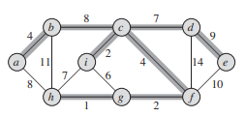
Minimum Spanning Trees
Minimum spanning trees is an undirected, weighted, connected spanning tree that has less than or equal weight to the weight of any other spanning tree that can be made with the given tree
# of edges = (vertices – 1)
Two algorithms to go over: Kruskal’s and Prim’s Algorithm
Both Algorithms use a greedy approach and grow one edge at a time
Notes:
Where do we see spanning trees in the real world? Communication networks as telephone lines, paving paths, or even airlines figuring out where flights should take off and land, the list goes on and on
Go to slide and walk through it
A greedy algorithm makes the choice that looks best at the moment as we learned in mod 6 just a few days ago
For the graph: A minimum spanning tree for a connected graph. The weights on edges are shown, and the edges in a minimum spanning tree are shaded. The total weight of the tree shown is 37. This
minimum spanning tree is not unique: removing the edge b; c and replacing it with the edge a, h; yields another spanning tree with weight 37.

Slide 3
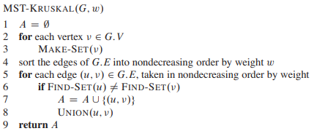
Kruskal’s Algorithm
Create an empty set A and |V| trees
Examine edges in order of weight (lowest to highest)
Check if endpoints are in same tree
If they aren’t then we add the edge to A and merge the vertices in the trees
Notes:
Lines 1–3 initialize the set A to the empty set and create a V trees, containing each vertex. The for loop in lines 5–8 examines edges in order of weight, from lowest to highest. The loop checks, for each edge .u;v /, whether the endpoints u and v belong to the same tree. If they do, then the edge .u; v/ cannot be added to the forest without creating a cycle, and the edge is discarded. Otherwise, the two vertices belong to different trees. In this case, line 7 adds the edge .u; / to A, and line 8 merges the vertices in the two trees

Slide 4
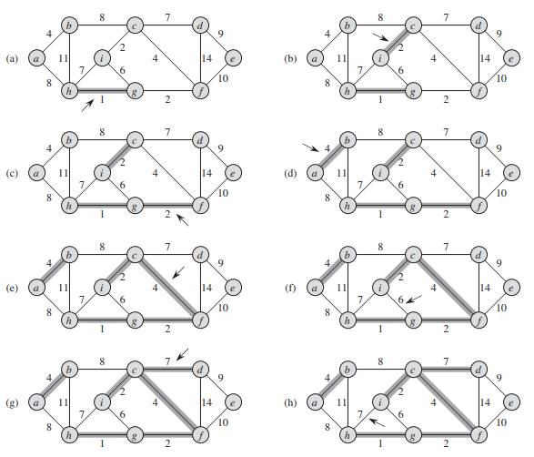
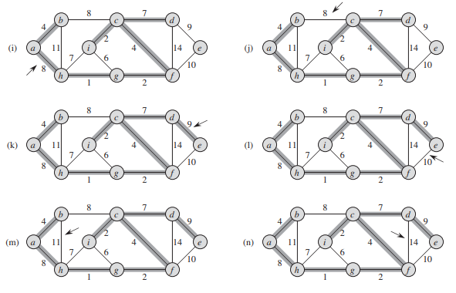
Kruskal’s Algorithm

Slide 5
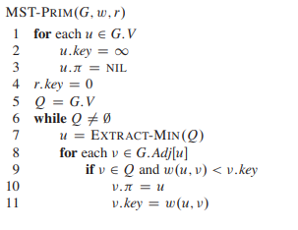
Prim’s Algorithm
Initialize the spanning tree at a random vertex
Find edges that connect the tree to vertices not visited yet
Find the minimum weighted move to a vertex that has already been visited and add to the tree
Repeat until we have our minimum spanning tree
Notes:
Prim’s algorithm operates much like Dijkstra’s algorithm for finding shortest paths in a graph
Lines 1–5 set the key of each vertex to infinity (except for the root r, whose key is set to 0 so that it will be the first vertex processed), set the parent of each vertex to NIL, and initialize the min priority queue Q to contain all the vertices. In the while loop, we look for the lightest edge from the current vertex or past visited vertices, once we have that we add the key and move to the next minimum value as long as we don’t visit a vertex twice until the minimum spanning tree is complete

Slide 6
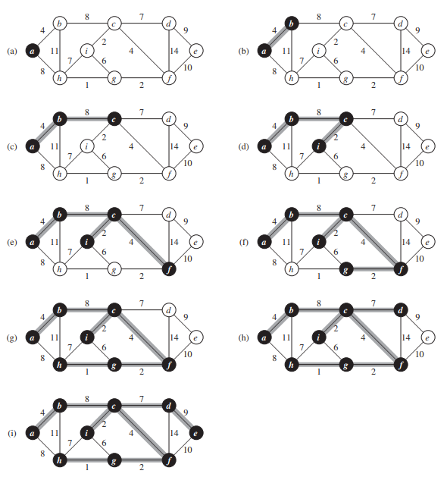
Prim’s Algorithm

Slide 7
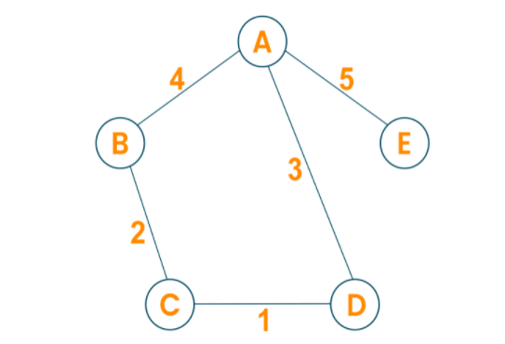
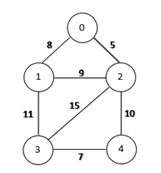
Example in Python
Kruskal
Prim

Slide 8
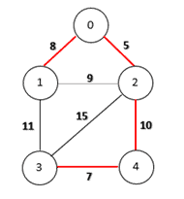
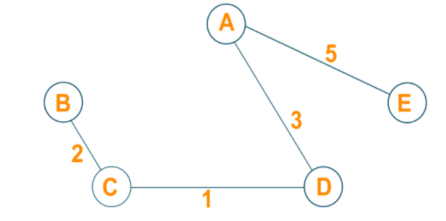



Example in Python
Kruskal
Prim

Slide 9
Sources
https://www.geeksforgeeks.org/kruskals-minimum-spanning-tree-algorithm-greedy-algo-2/
https://www.programiz.com/dsa/prim-algorithm
https://edutechlearners.com/download/Introduction_to_algorithms-3rd%20Edition.pdf
https://favtutor.com/blogs/prims-algorithm-python
https://www.pythonpool.com/kruskals-algorithm-python/

